Slide 1
Using virtual reality to assess the effects of stress
Dr Brad Wright Ph.D, b.wright@latrobe.edu.au
Senior Lecturer, School of Psychological Science & Public Health
July 2018
Title of presentation
Name of presenter
Title of presenter
School / Faculty / Division
xx Month 201x

Slide 2
Insert Polls 1 & 2 here

Slide 3
Why Jockeys ?
Only offshore fishing is a more dangerous occupation than being a horse jockey. On average there are 1.5 jockey fatalities annually, which from a workforce of 650 active jockeys in Australia represents a significant mortality risk in young employees.
Jockeys are at high risk of injury (Hitchens et al., 2009), and this may be compounded by chronic stressors that include managing their diet and weight, and working long hours, while rewards are received sporadically (Dabscheck, 2015).
Balanced circadian rhythms !!

Slide 4
High stress = poor decision-making, but…..
Stress induced changes in decision-making have been largely accredited to autonomic or endocrine stress reactions, with such physiological changes then affecting brain regions associated with decision-making (Starcke & Brand, 2012).
The physiological systems typically activated in stress responses, most notably the HPA axis and the autonomic nervous system, are also seen to play integral roles in effector mechanisms involved in brain regions and circuits for information processing (Starcke & Brand, 2012; Sandi, 2013).
La Trobe University
Notes:
Depends on the measurement
Sdelf-report vs behavioural (absenteeism, productivity etc.), vs morbididity, vs mortality vs stress physiology vs

Slide 5
Ok, but where is the evidence?
Research examining the effects of chronic stress on decision-making is limited however, with only three known studies concurrently assessing physiological self-reported indices of chronic stress (i.e., Landolt et al., 2017; Radenbach et al., 2015; van Honk et al., 2003). Taken together, the findings suggest that inter-individual differences in stress reactivity may be an important predictor of poor decision-making.
Understanding this link better will provide an avenue for targeted intervention and will assist in identifying those ‘at risk’ of poor decision-making
La Trobe University
Notes:
Stress ensues when demands exceed coping skills- maybe…
My take on how stress gets in: neg appraisal of primary interest to the participant- neg appraisal results in negative affect- negative affect triggers dysregulated stress physiology, which triggers morbidity which triggers mortality.

Slide 6
Decision-making is broadly defined in this study as the speed and accuracy of responses to stimuli, and the importance of this definition lies in the recognition that these attributes are recognised as integral components of higher order decision-making (Noorani & Carpenter, 2016).

Slide 7
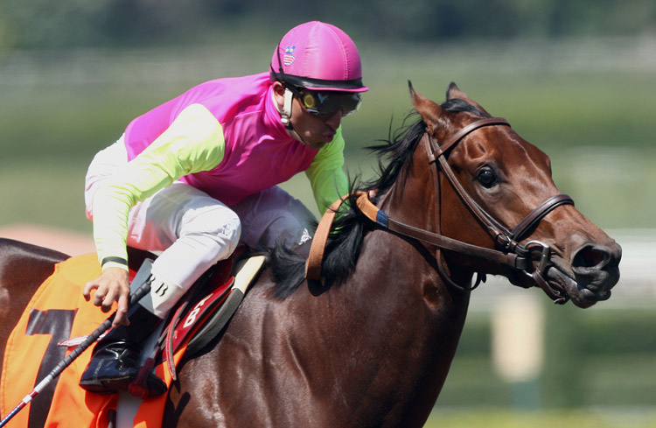
Participants
The apprentices, aged between 16 and 24 years of age in an Apprentice Jockey Training Program, usually start their days at 3am and undergo a demanding regime of training, travel and competing before returning home around 7pm to study the next day's form.

Slide 9
Stage 2
Jockeys completed computerised cognitive tasks (Cogstate) on two occasions; September and November (naturally occurring lower and higher stress periods), either side of an acute stress test. They provided saliva samples immediately upon awakening and again 30 mins. later.
We assessed if decision-making and reaction time changed over low and high stress periods and if the decision-making and reaction time altered before and after the acute stress test.

Slide 10
Cogstate

Slide 11
The MAST

Slide 12
When you are asked to immerse your hand in the water, do it like this:
If you’ve finished reading the instructions above and do not have questions, press the Space button.

Slide 13
Even more important!!!
This procedure can be experienced as unpleasant and even painful. Thus, as in any other study, you have the right to withdraw from the task and end your participation in this study at any time.
This right is granted to you by law and must be guaranteed to participants according to the protocol approved by La Trobe University Human Research Ethics Committee
If you’ve finished reading the instructions above and do not have questions, press the Space button.

Slide 14
FINDINGS
ERI differed between high and low stress periods. The ERI increase was driven by decreased perceptions of reward during the high stress period
The CAR was associated with ERI in both high and low stress periods (low stress r = .36; high stress r = -.37),
Substantially more jockeys reported ERI scores >1 in the high stress (54%) compared to the low stress period (11%).

Slide 15
The MAST manipulation induced a stress response

Slide 16
The MAST did not alter DM pre-post in either high or low stress periods
Table 4. A comparison of pre MAST to.
Stress period | Variable | N | t | p | d
Low | Simple reaction time | 32 | 0.73 | .467 | 0.19
Low | Choice reaction time | 32 | 0.28 | .782 | 0.07
Low | Processing speed | 32 | 0.10 | .917 | 0.03
High | Simple reaction time | 32 | 0.48 | .635 | 0.08
High | Choice reaction time | 32 | 1.67 | .104 | 0.35
High | Processing speed | 32 | 1.98 | .057 | 0.38

Slide 17
Those with ERI >1 had substantive decrements in decision-making

Slide 18
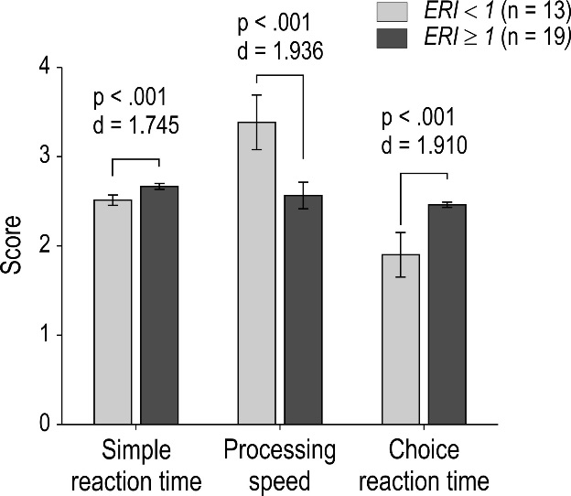
,

Slide 19
So, the speed and accuracy of their decision-making was diminished…….
ok, what does that mean exactly?

Slide 20
Insert Poll 3 here

Slide 21
“Jockeys had decrements in their decision-making that were comparable with having a blood alcohol concentration (BAC) of 0.08%.”

Slide 22
*Interestingly, processing speed and choice reaction time were the most complex of our decision-making and reaction time assessments and these were most impacted by higher ERI and LF/HF ratio.
The ERI ratio cut off (ERI >1 vs ERI ≤1) and a higher LF/HF ratio across the acute experiment interact to best explain the relationship with poor choice reaction time and processing speed
*What these findings hint at, but cannot validly infer, is that jockeys are at risk of falls and poor or dangerous performance when experiencing increased stress as assessed by ERI and LF/HF ratio.
*The challenge for future research will be to assess the ecological validity of our findings

Slide 24
Figure 2. Illustration of the association between ERI and Choice reaction time for those with low (n = 49) and high (n = 30) levels of sAA reactivity.

Slide 25
Stage 3 CONVIRT
CONVIRT is a built-for-purpose virtual reality tool that has been successfully created to more realistically assess a jockey’s decision-making in their working environment.
Importantly, CONVIRT uses eye tracking technology to measure the speed of ocular movement in response to stimuli to assess visual processing speed.
We anticipate that we will be developing similar technologies for other sporting codes and occupations where the consequences of poor decision-making are dire.

Slide 26
Virtual reality decision-making tool (CONVIRT)
Jockey will ride the mechanical horse and view the virtual race track through the Oculus Rift Head Mounted Display (HMD),

Slide 27
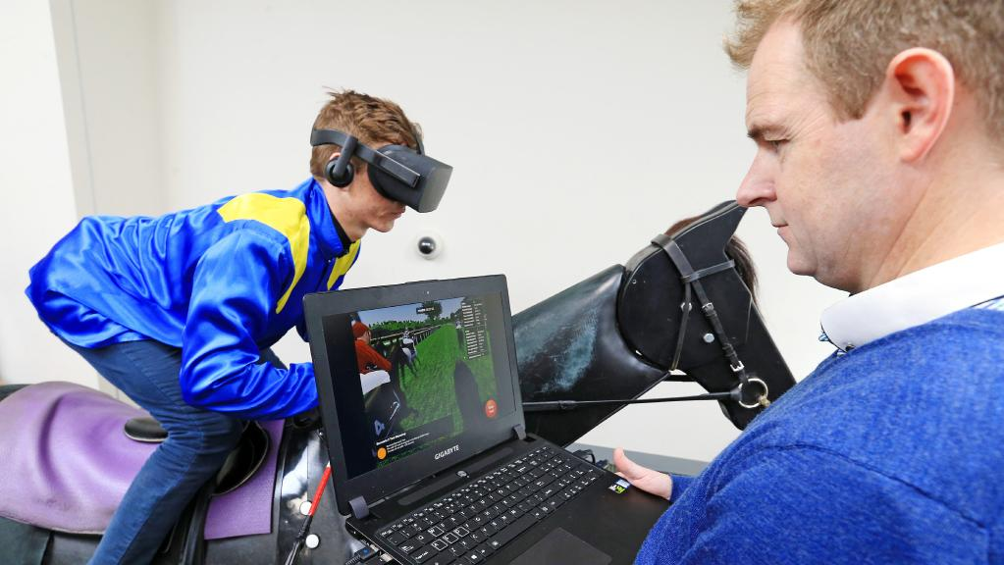

Slide 28
(b) Riding crop has a custom integrated Bluetooth button to detect jockey response

Slide 29
(c) Virtual environment (VE) shows the randomly generated geometric cues

Slide 30
CONVIRT to Cogstate HRV comparison

